Slide 1
Software Engineering
Lecture #24
Fakhar Lodhi

Slide 2
Architectural Styles and Models

Slide 3
Summary of Today’s Lecture

Slide 4
Recap

Slide 5
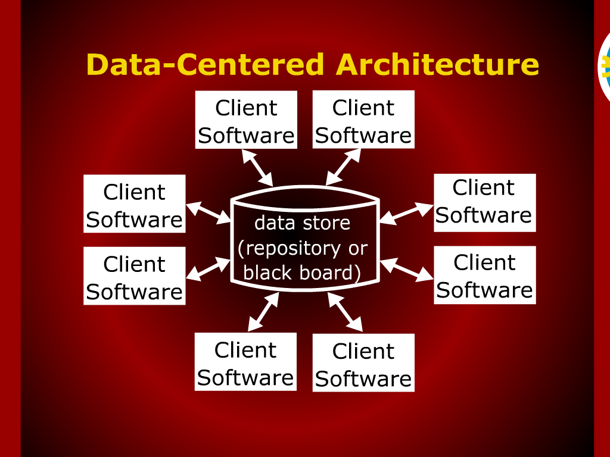
Data-Centered Architecture

Slide 6
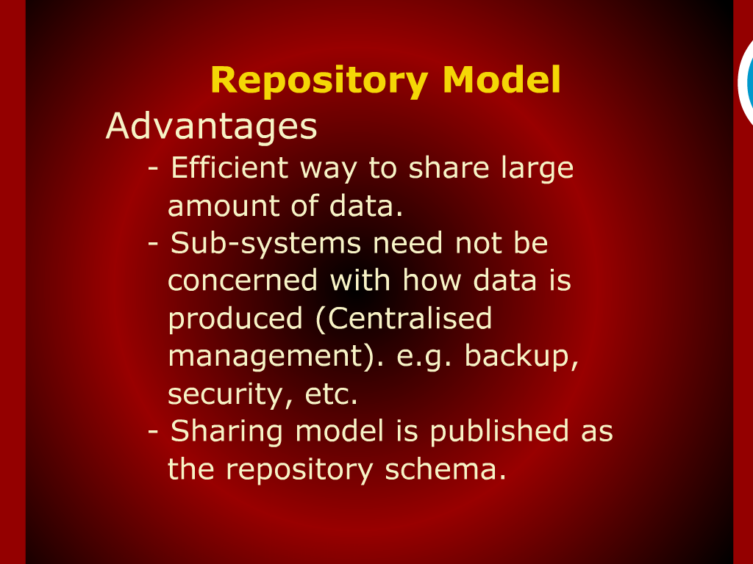
Repository Model

Slide 7
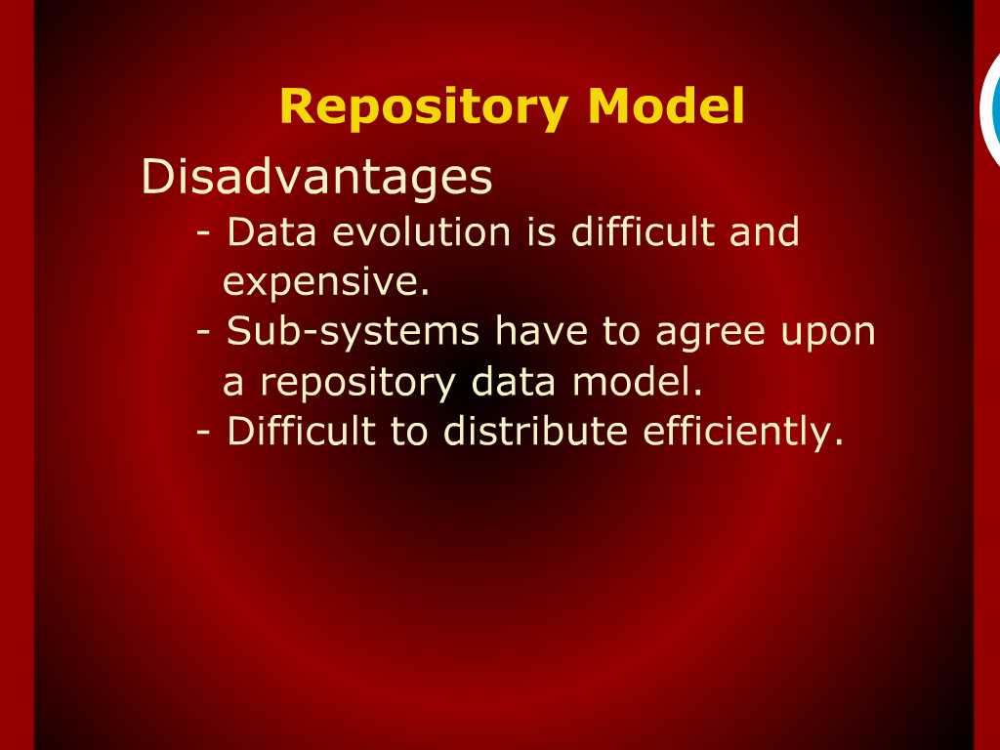
Repository Model

Slide 8
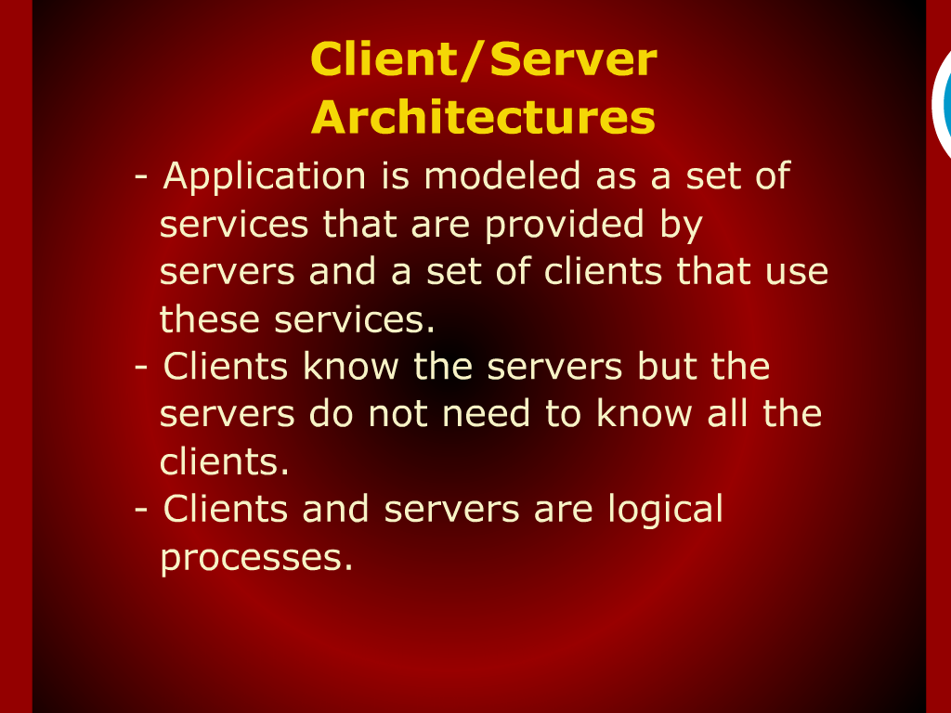
Client/Server
Architectures

Slide 9
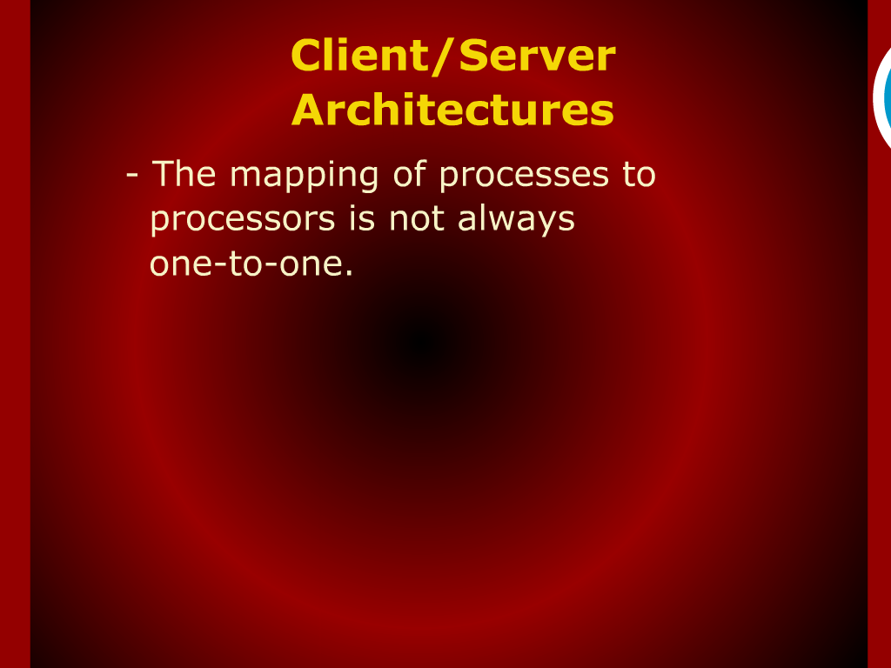
Client/Server
Architectures

Slide 10
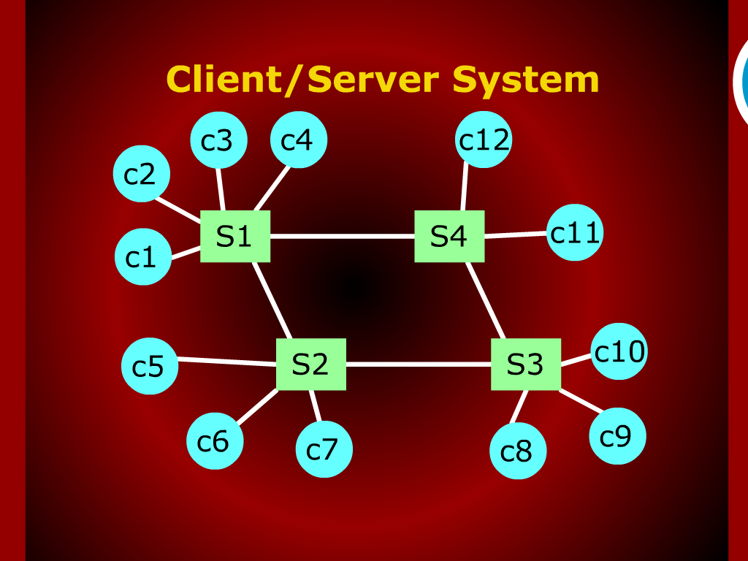
Client/Server System

Slide 11
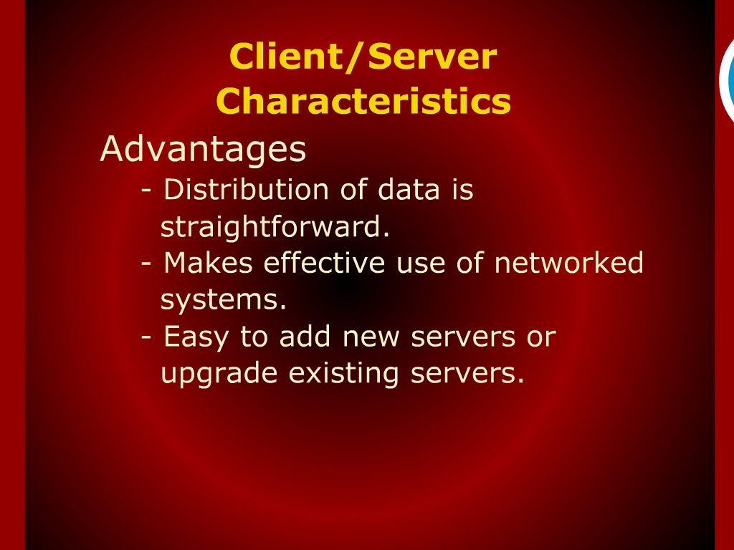
Client/Server
Characteristics

Slide 12
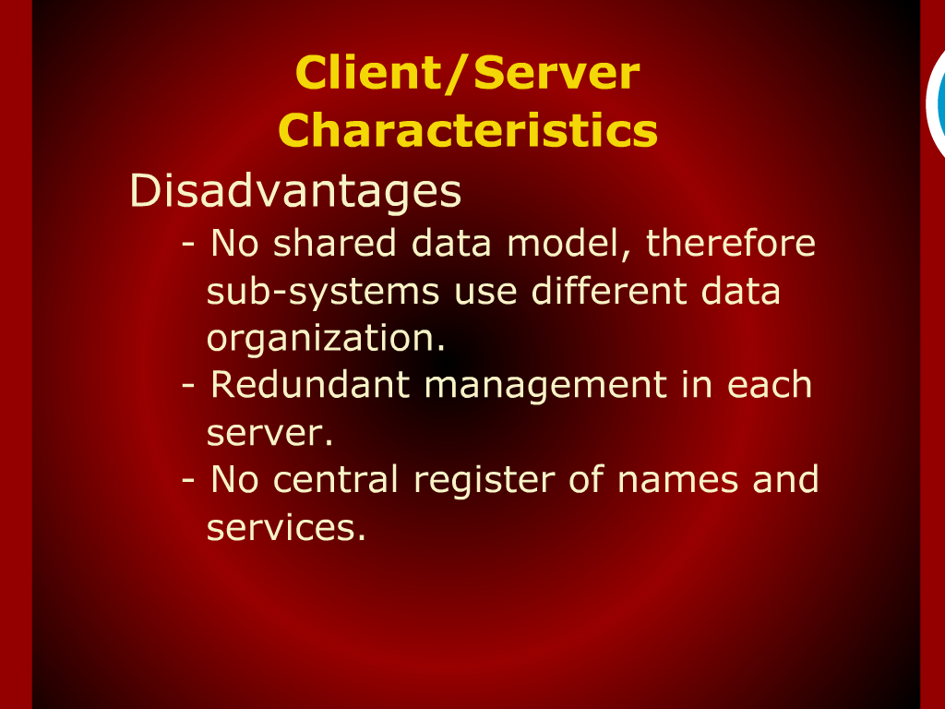
Client/Server
Characteristics

Slide 13
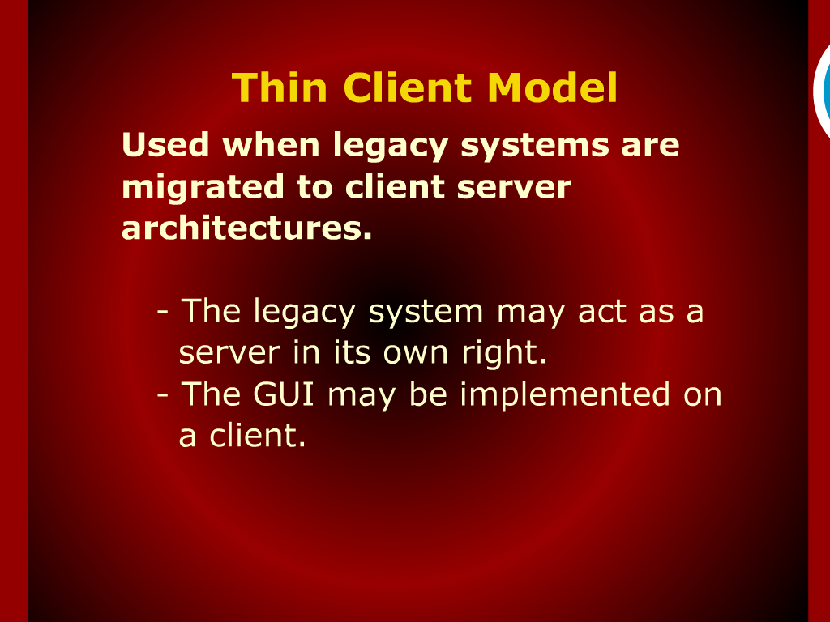
Thin Client Model

Slide 14
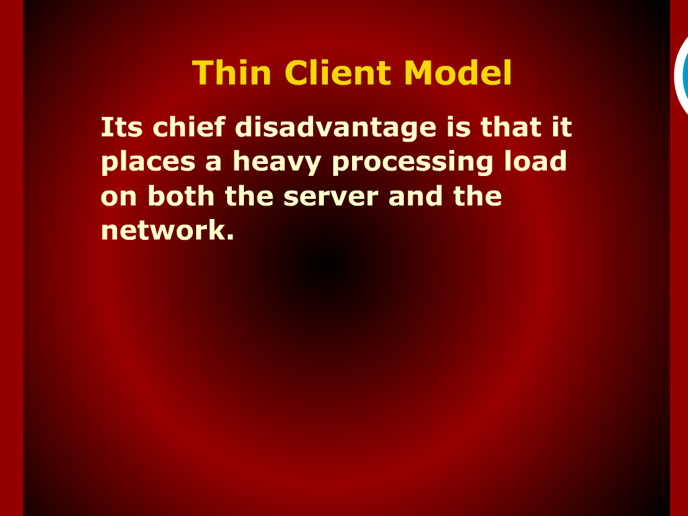
Thin Client Model

Slide 15
Data-Centered Architecture

Slide 16
Client/Server Architectures

Slide 17
Representative Client-Server Models

Slide 18
Fat Client

